Slide 1
Online Food Delivery System
Software Engineering Project

Slide 2
Agenda
Introduction
Abstract
Diagram
Modules
Conclusion

Slide 3
Introduction
The main objective of the system is to develop a customer friendly software where they can order the food easily by adding the items they wish to have in a cart, make the payment and have their food within a few steps.

Slide 4
Abstract
When the customer first opens the software, he will be led to the recommendations page where the best cuisine will be displayed .The items which they wish to order will be added to a cart. Finally when they are done selecting all the items, they can view the cart and then update it. They can increase the quantity of the items, they can also remove the item and can also go back to ordering more., they will be led to a page where they will enter payment details The customer can then review his order, the entire bill, his details and confirm them. Finally in the checkout page they will be provided with multiple options to pay such as COD,Credit/Debit card, After the payment is processed the customer can track his order and the ETA.

Slide 5
Plan for product launch
Deploy strategic networks with compelling e-business needs
LifeCycle Selection
Planning and Development Tools
Component Building
Coordinate
Foster holistically superior methodologies
Launch
Strategy
e-business applications
Agile,Scurm
Jira,Github,selenium
1
2
3
4
5

Slide 6
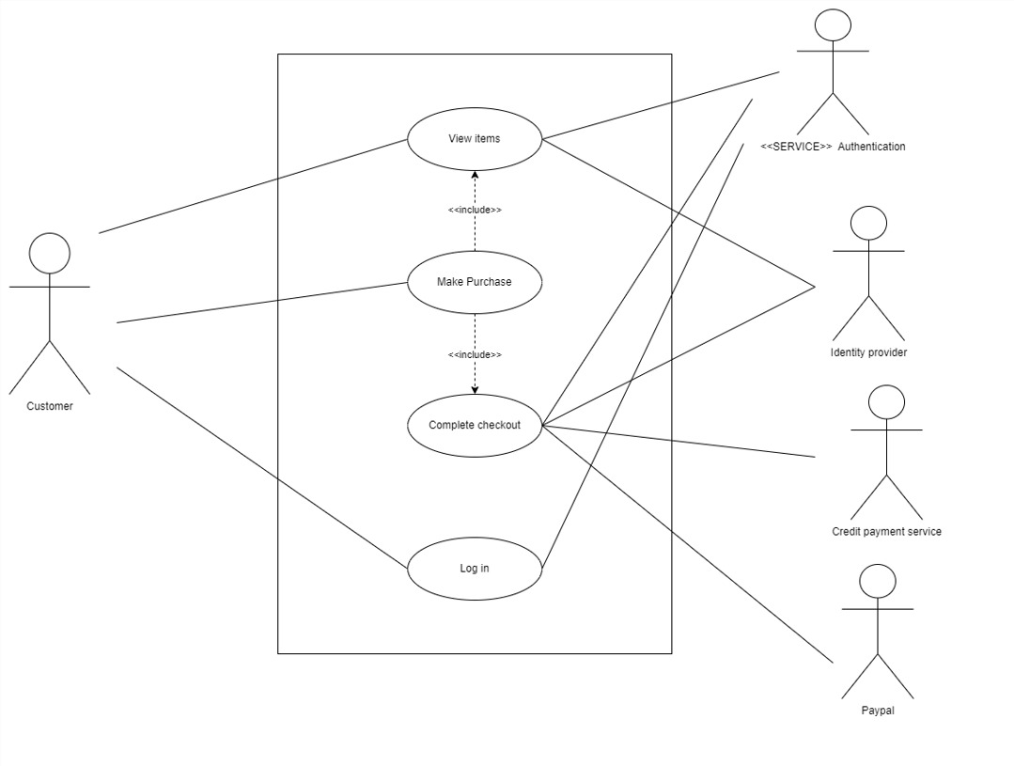
Diagram

Slide 7
Business opportunities are like buses. There's always another one coming.
“
”
Richard Branson

Slide 8
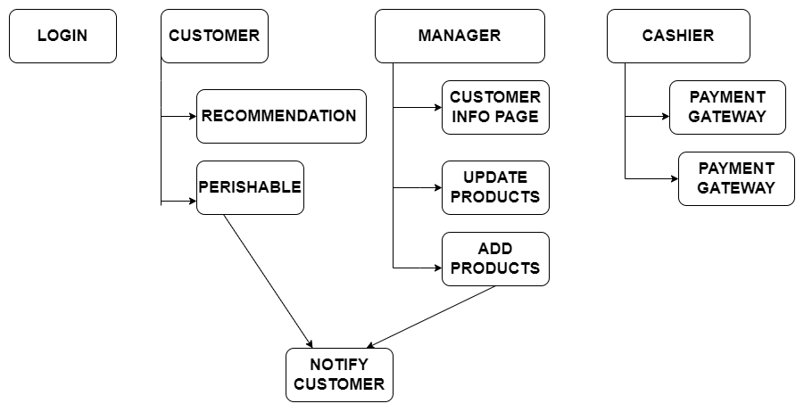
Modules

Slide 9
Conclusion
Our initiative is merely a modest effort to meet their requirement for project management. Many user-friendly coding styles have also been adopted. This bundle will prove to be effective.

Slide 10


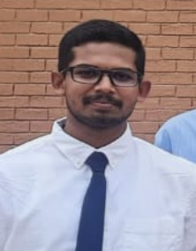

Meet our team
V Raghav Loknath
PES2UG20CS375
Vishwas M
PES2UG20CS390
Developer
Project Manager
Vishal C E
PES2UG20CS386
Vishnudeep M R
PES2UG20CS388
Tester
VP

Slide 11
Thank you

